Slide 1
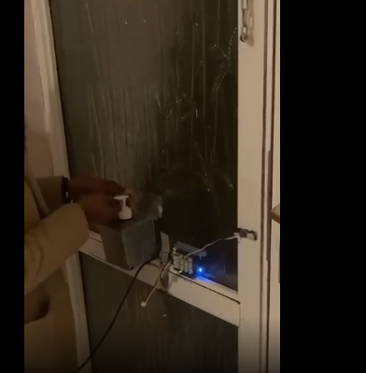
Arduino Hand Sanitiser
By Jamie Bredin, Sean Henry, Rian Bolger, Ariane Dos Santos

Slide 2

Introduction

Slide 3
Introduction, Roles
Myself and Rian had the role of making the prototype.
Jamie's role was to make the code for the prototype to work.
Ariane's role was to research the project and a to act as the group's observer.

Slide 4
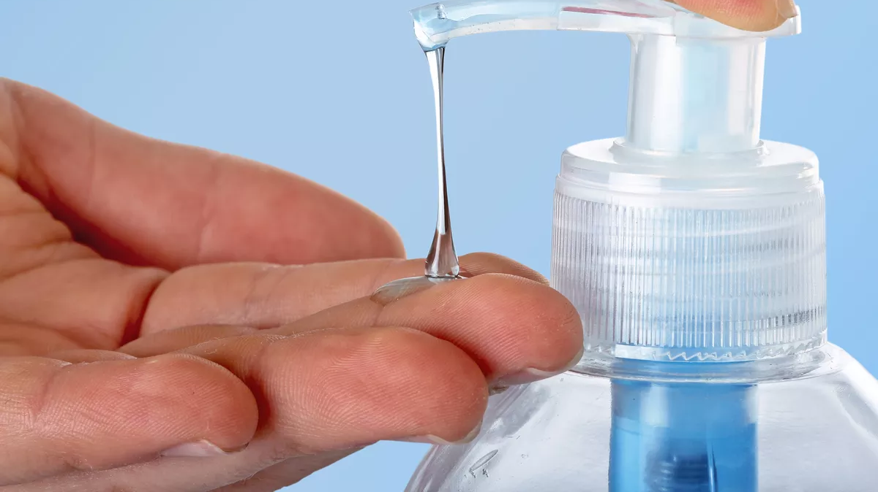
Problems to be solved

Slide 5


Slide 6

What you are going to see

Slide 7
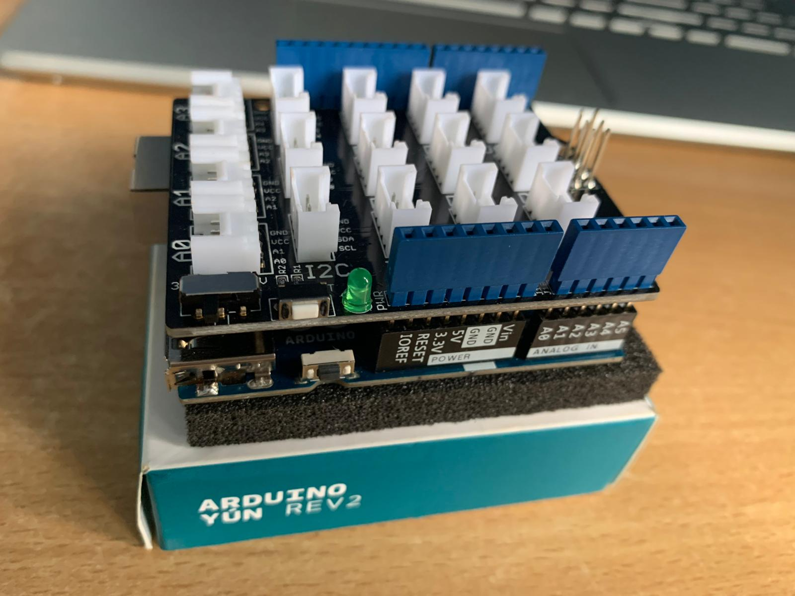
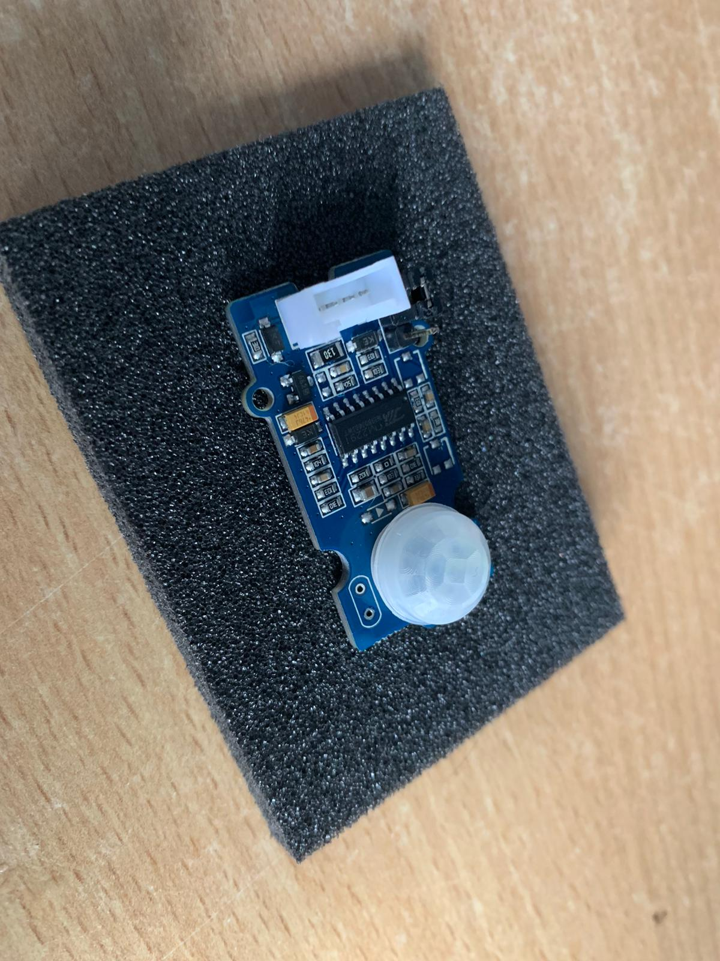
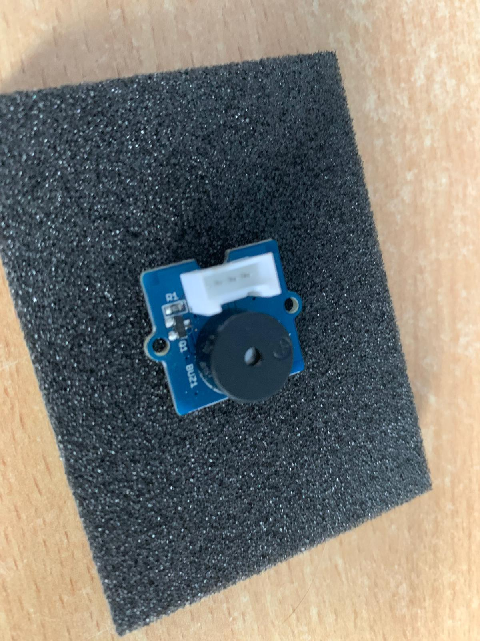
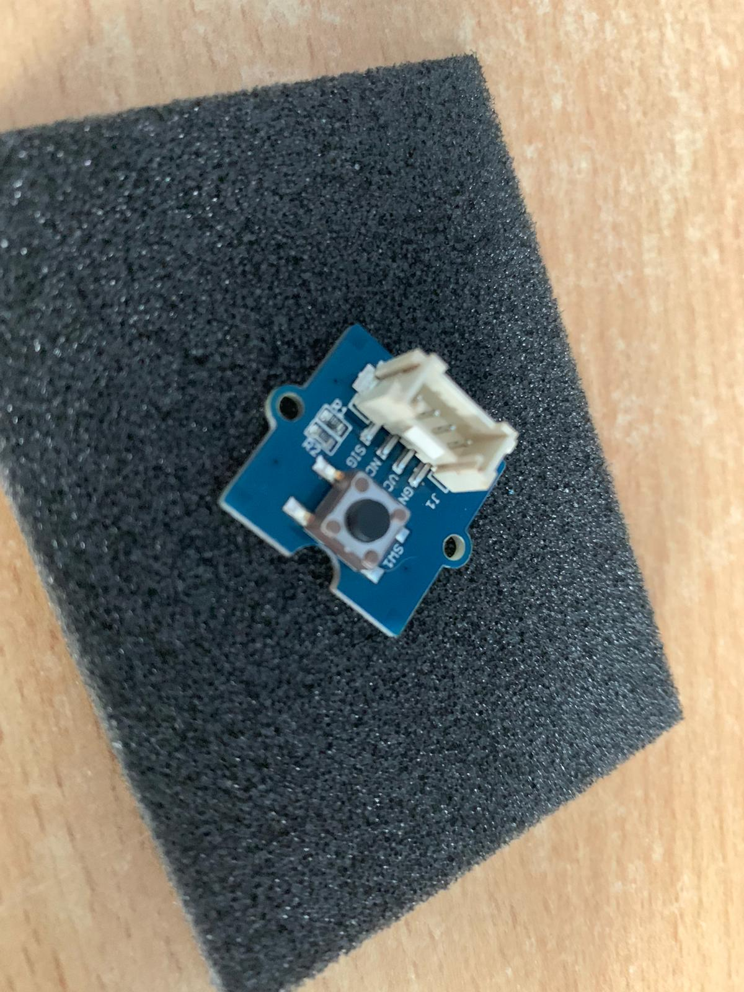
Arduino Yun Hand Sanitizer

Slide 8
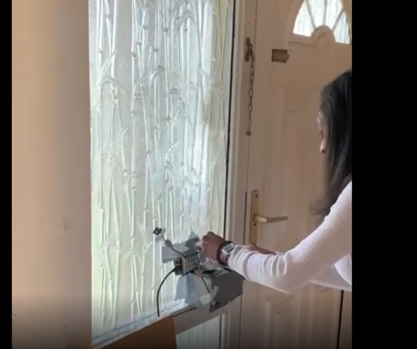
What you will see

Slide 9
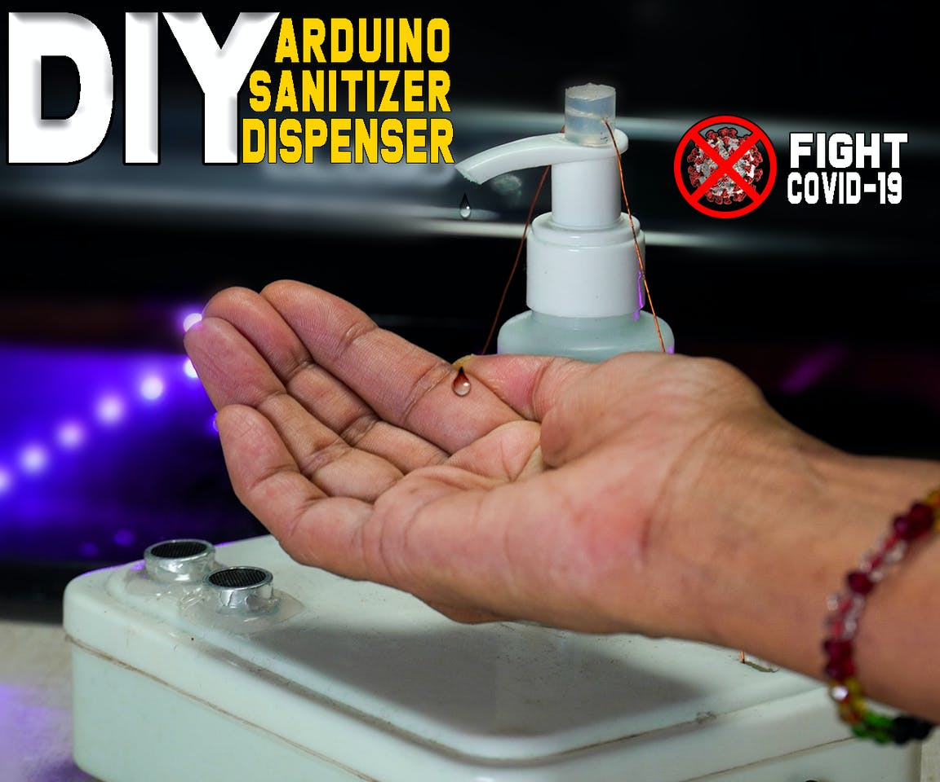
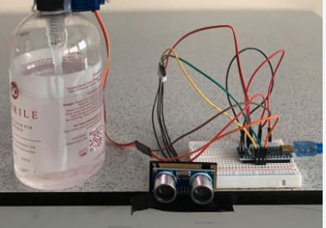
Research

Slide 10

The Demo -Video

Slide 11
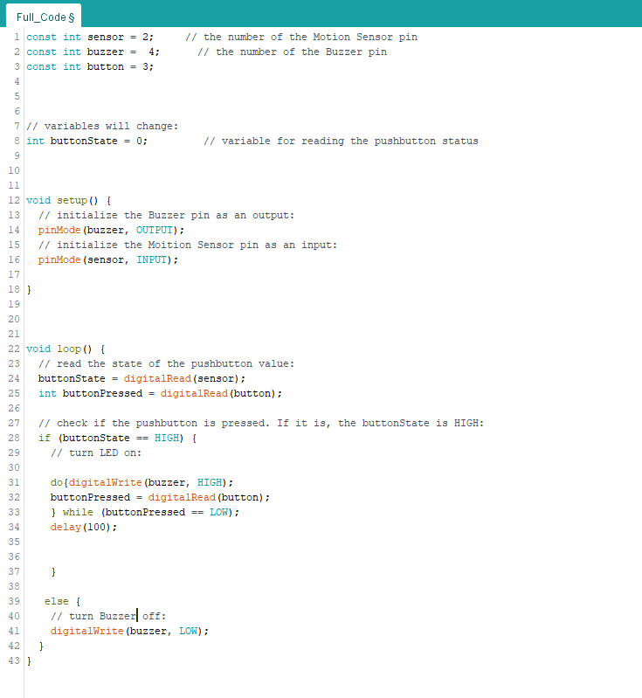
The Code

Slide 12

Challenged we faced and overcame

Slide 13
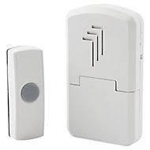

Future

Slide 14

Question & Feedback

Slide 15

End of slide

